Slide 1

NEONATAL PAIN MANAGEMENT
Pediatric Pain PRN Curriculum
Notes:
Materials: Flip chart or whiteboard and Markers
Provide participant guide at least one week in advance.
3 Index cards per participant
Room Setup: In tables of 4 or 6-8 depending on number of participants
Display slide as participants walk in
This session is 45 minutes
Welcome and Introductions: Introduce facilitator if necessary
READ: This material builds on the foundational pediatric pain assessment and management content covered in this curriculum and focuses on pain as it is experienced by neonates, including critically ill neonates hospitalized in neonatal intensive care units. The learning objectives for this section are to:
Objectives:
Explain the significance of fetal neurodevelopment on nociception in preterm and term neonates
Describe the prevalence of pain in preterm and term neonates
Identify pain assessment and management challenges in preterm and term neonates
Explain the potential long term impact of poorly controlled neonatal pain and current pain management strategies used to treat pain experienced by pre-term and term neonates

Slide 2
We don’t hurt babies anymore, do we?
Notes:
ASK: What are some of the myths that you need to “bust” when it comes to neonates and pain?
Select participants willing to share their answers to this question.
Write on flipchart or board [Limit to 1 minute]

Slide 3

What common sources of pain are experienced by neonates in hospitals?
Of these, which are unique to babies in the NICU?
Notes:
READ: Pair up for this “Pair and share activity.”
Each group should identify 5 common sources of pain that are unique to neonates. [Limit to 2 minutes]
Select participants from each group to share their answers to this question.
Write on flipchart or board [Limit to 2 minute]
Place a ✓ by those items that are repeated by the groups.
[5 minutes of 45 minute session is complete]

Slide 4
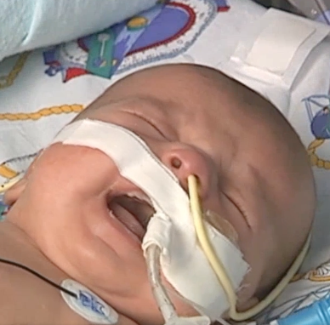
Prevalence of pain in NICUs
9% of newborns admitted to NICUs (Walker, 2013)
Barker & Rutter study (1995):
54 infants
>3000 procedures
74% in < 31 weekers
A 23 weeker had 488 procedures
Stevens et al study (2001):
27-31 weekers
Median of 134 procedures/baby
SD 144, Range 0-821
10% of youngest & sickest had >300 procedures
Carbajal et al study (2008):
430 neonates,
42,413 painful first attempt procedures in 2 weeks
Median of 115 procedures/baby during the study
16/day of hospitalization
21% received analgesia prior to painful procedures
34% received ongoing analgesia
Notes:
READ: How common is pain in NICUs?
Pretty common

Slide 5
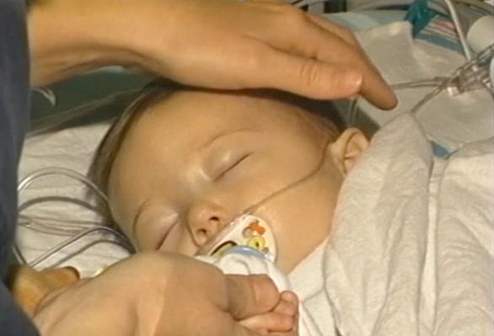
Consequences of poorly controlled pain in neonates
Nociceptive pathways functional as early as 25 weeks
Sensory/Perception
Behavioral Responses
Social/Family Interactions
Developmental/Cognitive Consequences
Notes:
ASK: What are consequences of unmanaged pain in neonates?
Select participants willing to share their answers to this question.
Write on flipchart or board [Limit to 3 minute]
READ: these Key points (if not included by participants):
Sensory/Perception: 1) Altered balance between excitatory and inhibitory feedback mechanisms, 2) Poor localization and discrimination, 3) Poor noxious inhibitory modulation, 4) CNS sensitization, 5) Greater prematurity = greater pain
Behavioral responses: 1) Facial expressions, 2) Cry, 3) Body movement/Muscle tone
Hormonal/Physiologic response: 1) Increased cortisol, 2) Altered catecholamine levels, including depletion, 3) Elevated free radicals
Nociceptive pathways: functional as early as 25 weeks: 1) Incomplete myelination, 2) Shorter nerve fibers, 3) Larger cutaneous receptor fields

Slide 6
Pain Assessment Challenges
Notes:
READ: What are some common challenges you will face when assessing pain in neonates?

Slide 7

How is pain commonly assessed in neonates?
Notes:
ASK: What pain assessment strategies and techniques do you currently use for preterm and term neonates?
Select participants willing to share their answers to this question.
Write on flipchart or board [Limit to 3 minute]
ASK: How are these techniques captured in valid and reliable pain assessment tools for neonates:
PIPP/PIPP-r
NIPS
CRIES
FLACC
N-PASS
COMFORTneo
Select participants willing to share their answers to this question.
[Limit to 2 minute]
[15 minutes of 45 minute session is complete]

Slide 8
Jessica
Jessica’s parents ask how the nurses will know if Jessica is in pain. How would you answer?
What will a baby in pain look, Jessica’s parents ask the questions on this slide.…
like? Will a lethargic baby behave in the same way when in pain?
Jessica was born at 31 weeks gestation. Now 15 days old, she is hospitalized for monitoring of prematurity.
She is mildly lethargic.
Vital signs: HR179, RR 60, BP 50/32, oxygen saturation 88% & axillary T 38.0°C.
As the nurse is preparing for venipuncture to start IV fluids, Jessica’s parents as the questions on the slide.
Notes:
READ: The nurse suspects Jessica is septic and begins a septic workup. This includes a urinary culture and an intravenous blood draw for complete blood count, electrolyte levels, & blood cultures. As the nurse is preparing for the venipuncture and urinary catheter insertion, Jessica’s parents ask the questions on this slide.…
With your table discuss your answers to the questions on the slide, and select a participant willing to share your groups’ answers. This is a 5 minute case.
[Give groups 4 minutes to discuss case & 2 minute to share answers to each question & 2 minutes to wrap up]
READ: these Key points (if not included by participants):
Infants cannot express pain verbally, so behavioral & physiological tools are used to assess pain. Facial activity is the most reliable and consistent pain behavior. Sleeplessness and cry can also be indicators of infant pain. These responses may be less obvious in a lethargic infant; therefore context is important to Jessica’s assessment.
Healthcare providers often default to physiologic indicators, such as heart rate, heart rate variability, oxygen saturation and changes in respiratory pattern. Physiologic indicators are not sensitive or specific for pain. Alone, they are not valid measures or indicators of pain. Therefore, they must be considered as part of a multidimensional pain assessment.
25 minutes of 45 minute session is complete]

Slide 9
Neonatal Pain Management
Notes:
READ: What challenges do you have when managing pain in neonates?

Slide 10
What are unique risks of analgesics and anesthetics used to manage pain in neonates?
Is sucrose pharmacologic or nonpharmacologic?
What biobehavioral strategies are used to manage pain in neonates?
Notes:
READ: Pair up for this “Pair and share activity.” Each group should discuss these three questions. [Limit to 3 minutes]
Select participants from each group to share their answers to this question.
Write on flipchart or board [Limit to 2 minute]
READ: these Key points (if not included by participants):
Risks of analgesics and anesthetics: Apoptosis, IVH, Periventricular leukomalacia, Decreased cognitive/motor development, Hypotension
Recall Valkenburg et al. (2015) continuous morphine (10mcg/kg/h) study:
Thermal detection and pain thresholds comparable
Chronic pain comparable
Normal neuro exam in 76% of morphine group: 61% in control
[30 minutes of 45 minute session is complete]

Slide 11

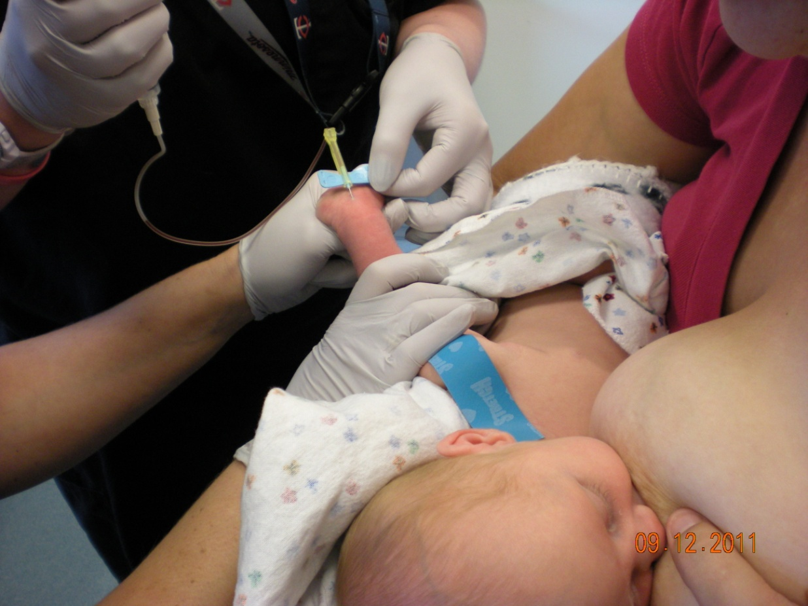
Management
Pharmacologic
Acetaminophen
Opiods
Topical anesthetics
Benzodiazepines
Volatile anesthetics
Other Medications
Gabapentin
Clonidine
Dexmedetomidine
Ketamine
Propofol
Others?
Biobehavioral (Non-Pharmacological or Non-Drug)
Skin-Skincare (Kangaroo care)
Breastfeeding
Pacing and Bundling Care
Managing the environment
White noise
Positioning
Sucrose
Glucose
Massage
Music
Others?
Notes:
ASK: Are there any other neonatal pain management strategies you use that are not included on the list?
Select participants willing to share their answers to this question.
Write on flipchart or board [Limit to 3 minute]
[35 minutes of 45 minute session is complete]

Slide 12
Organizational Responsibilities
PRN
Pain prevention
& Pain care quality improvement
Evidence-based pain assessment & management practices
Ongoing education of providers & families
Research
SMART goals are:
Specific,
Measurable,
Achievable,
Results-oriented (focused),
Time-bound (limited)
Notes:
READ: In your role as a PRN, what will you do to improve pain management for neonates?
Work with your table to develop your answers into SMART goals.
Write your name and your most important SMART goal on 3 index cards
Be prepared to share your SMART goals with the group [Limit to 5 minutes]
Select participants willing to share their SMART goals.
Write on flipchart or board [Limit to 3 minutes]
Collect 2 of 3 Index cards from each participant (1 for participant, 1 for reminder in 1 month and 3 months)
[43 minutes of 45 minute session is complete]

Slide 13
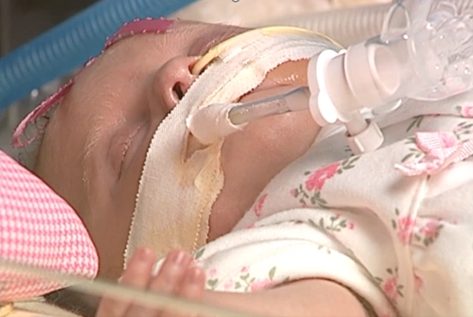
Key Points
Pain is too common in the neonatal period.
Pain has a negative impact on neonates.
Pain has long-term consequences
Appropriate assessment tools exist for neonates
We can safely and effectively manage pain in the neonatal period.
Balance benefits and harm.
Multimodal treatment options exist.
Healthcare organizations have an obligation to treat pain.
You are SMART and you can improve neonatal pain management
Notes:
READ: The key points on the slide

Slide 14

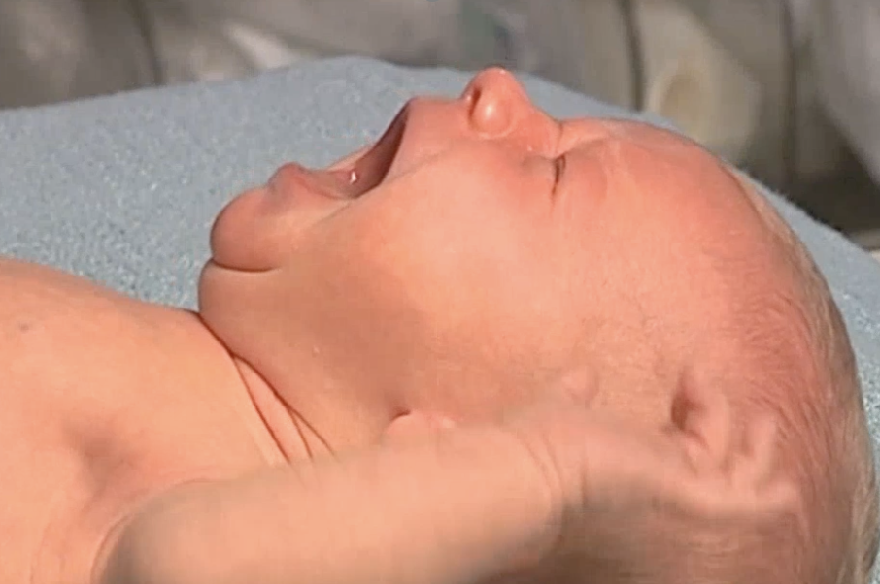
How would you rate your ability to assess pain in neonates?
How would you rate your ability to manage pain experienced by neonates?
What resources do you need for your team?
What is your next step?
Notes:
ASK: Are there any questions?
[45 minutes SESSION COMPLETE]

